Slide 1
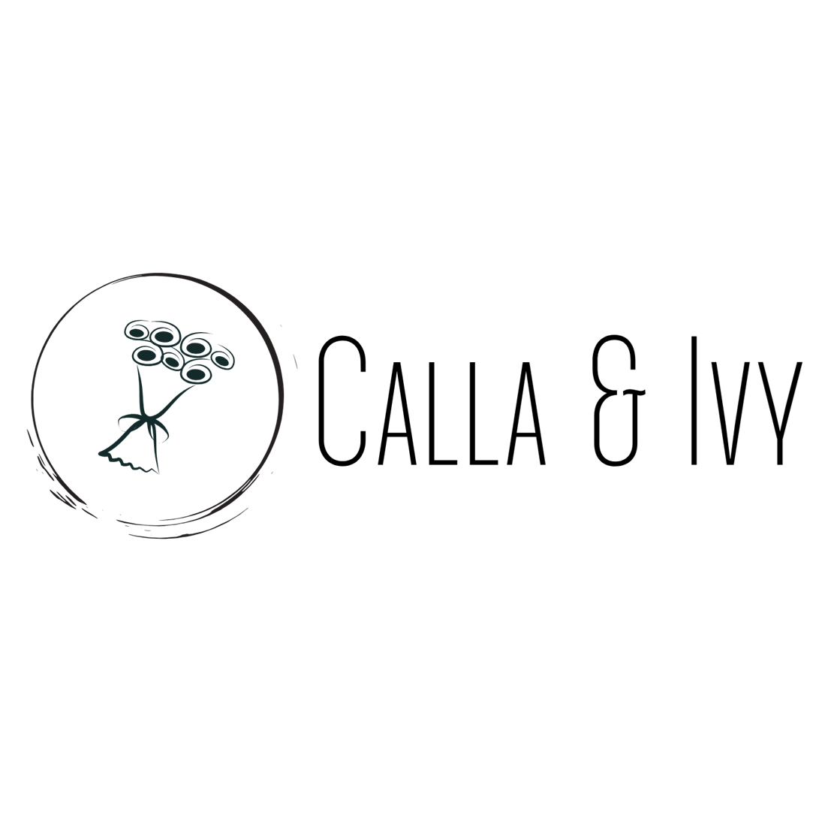

Calla & Ivy Flower Campaign

Slide 2
Goal
Campaign Objective:
10% sales increase by end of Q1
KPI:
Conversion Rate

Slide 3

Creative
Assets
Image placeholder

Slide 4
Campaign
Settings
Objective:
To offer fall bouquets
Audience:
Women
Ages between 24 and 55 years old
Love cut flowers
Placement:
Facebook, Instagram and the Audience Network
Duration:
6 Nov 2020 – 15 Dec 2020
Budget:
$4000

Slide 5
Results
Campaign Result
Free Shipping more popular
2.75 times more spending
6.25 times more reach
Campaign Cost
$2824.50
ROAS:
Revenue
$32,280
ROAS = 11.43
Total Investment
Advertising: $2824.50
Cost: $12,105.00
Total Investment: $14,929.50
ROI:
ROI = 1.16

Slide 6
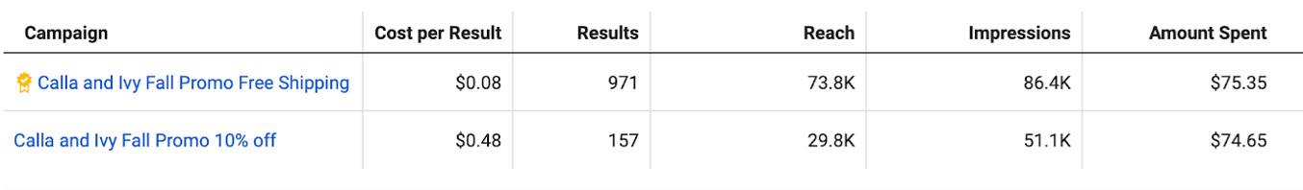

A/B Test Results
A/B Testing of 2 offers during campaign
Free Shipping has higher reach and impressions

Slide 7
Conclusion & Next Steps
Calla & Ivy can clearly conclude that ‘Free Shipping’ is a better strategy to go with than ‘10% Off’
Integrate WhatsApp and Messenger as new outreach
Work on Bid Strategy, Ad Placement and Optimization strategies to improve their cost per results

Slide 8
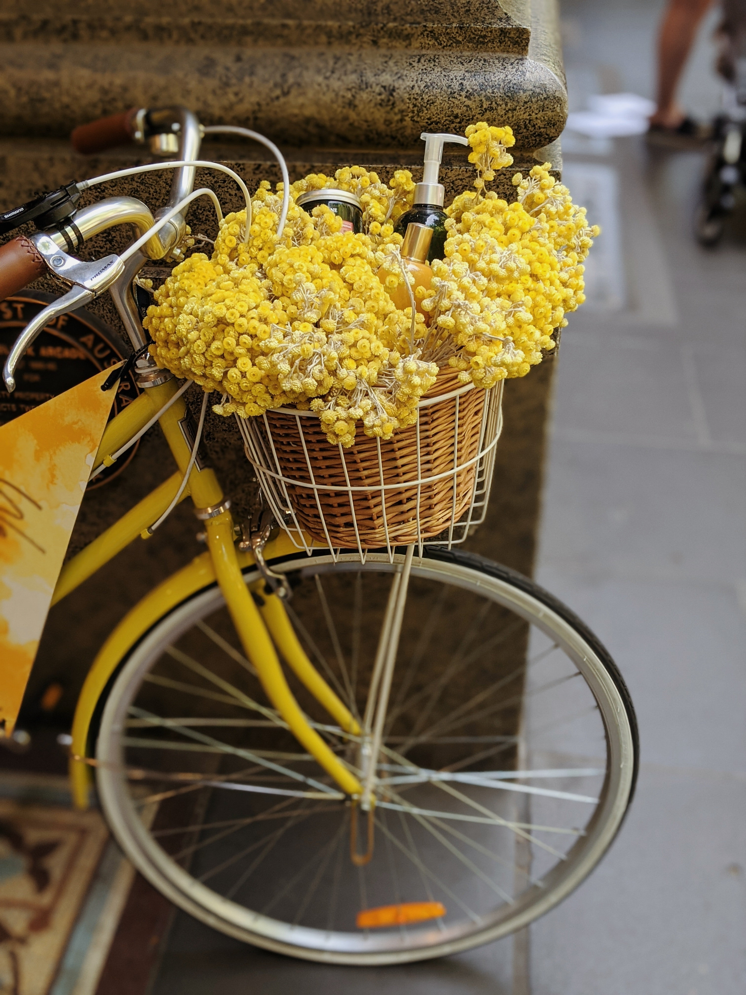

Thank
You!
Image placeholder

